Slide 1

DONE BY Dipesh Dilip Patne UNDER THE GUIDANCE OF PROF M.S MAHADIK
DR.BABASAHEB AMBEDKAR COLLGE
MAHAD,RAIGAD
S.Y.B.Sc CS SEM (III) (2025-2026)

Slide 2
Database-driven blood donor directory Study & design.
A database-driven blood donor directory system requires user-friendly study and design focusing on data collection, data management, and donor engagement. The study phase involves analyzing donor demographics and motivation, identifying barriers to donation, and understanding technological preferences for engagement. The design phase centers on developing a secure, scalable platform that streamlines registration, provides easy access for blood banks, and leverages mobile applications and social media for recruitment and retention.

Slide 3
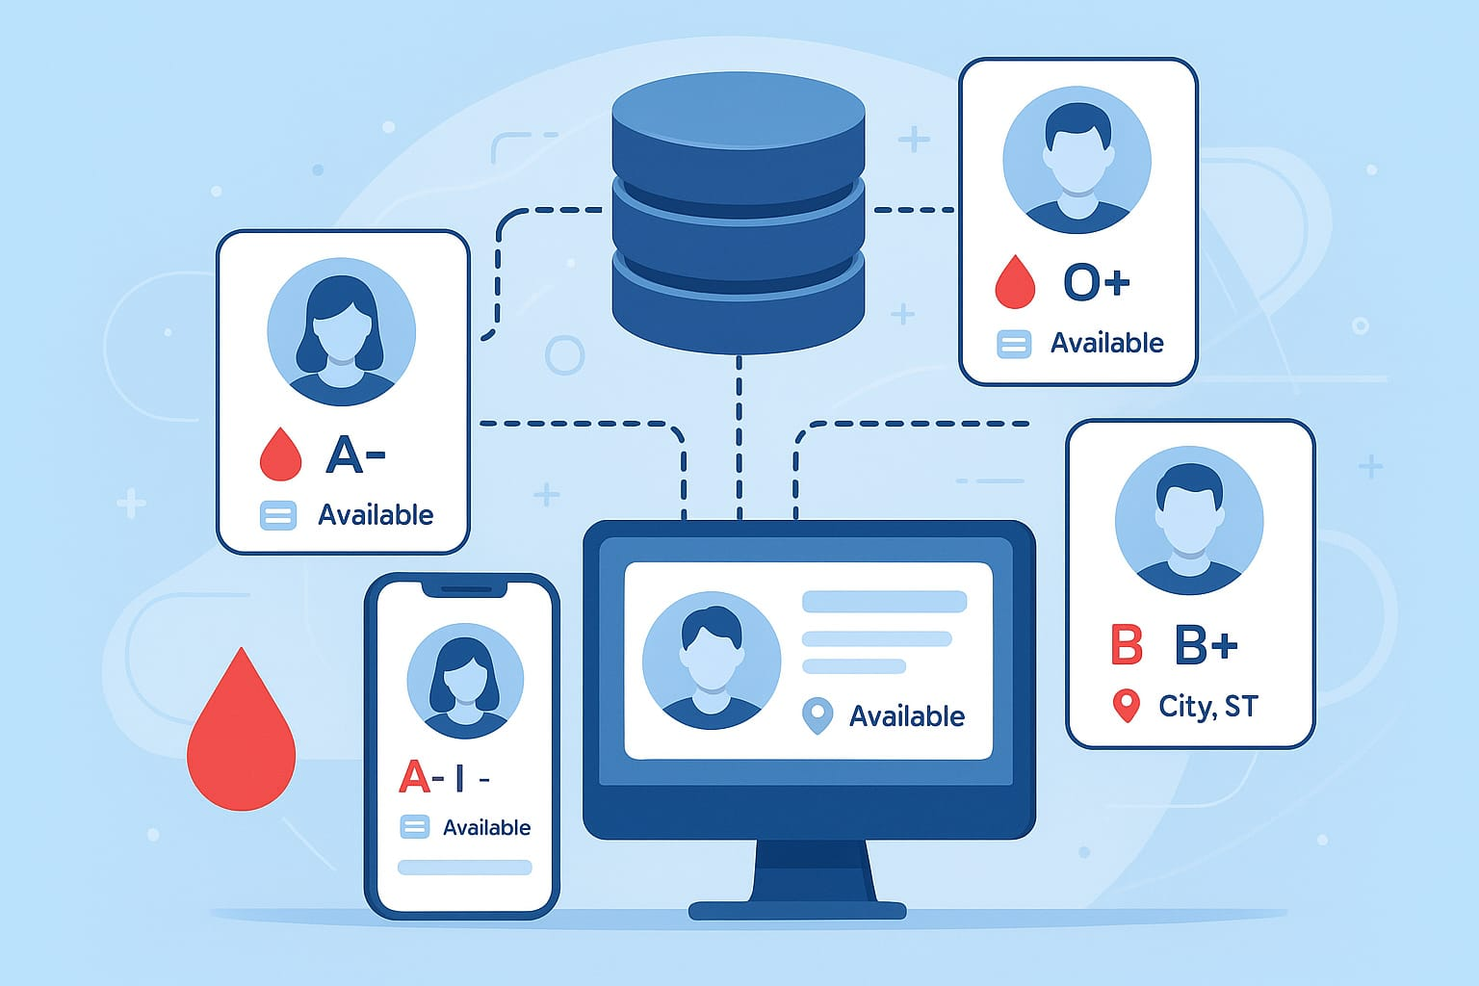

Slide 4
ABSTRACT

Slide 5
AKNOWLEDGEMENT

Slide 6
TITLE

Slide 7
INDEX

